Slide 1
Last Lecture Before Mid Term.

Slide 2
Software engineering ethics
Software engineering involves wider responsibilities than simply the application of technical skills.
Software engineers must behave in an honest and ethically responsible way if they are to be respected as professionals.
Ethical behaviour is more than simply upholding the law but involves following a set of principles that are morally correct.

Slide 3
Issues of professional responsibility
Confidentiality
Engineers should normally respect the confidentiality of their employers or clients irrespective of whether or not a formal confidentiality agreement has been signed.
Competence
Engineers should not misrepresent their level of competence. They should not knowingly accept work which is outwith their competence.

Slide 4
Issues of professional responsibility
Intellectual property rights
Engineers should be aware of local laws governing the use of intellectual property such as patents, copyright, etc. They should be careful to ensure that the intellectual property of employers and clients is protected.
Computer misuse
Software engineers should not use their technical skills to misuse other people’s computers. Computer misuse ranges from relatively trivial (game playing on an employer’s machine, say) to extremely serious (dissemination of viruses).

Slide 5
Types of requirement
User requirements
Statements in natural language plus diagrams of the services the system provides and its operational constraints. Written for customers.
System requirements
A structured document setting out detailed descriptions of the system’s functions, services and operational constraints. Defines what should be implemented so may be part of a contract between client and contractor.

Slide 7
Functional and non-functional requirements
Functional requirements
Statements of services the system should provide, how the system should react to particular inputs and how the system should behave in particular situations.
May state what the system should not do.
Non-functional requirements
Constraints on the services or functions offered by the system such as timing constraints, constraints on the development process, standards, etc.
Often apply to the system as a whole rather than individual features or services.
Domain requirements
Constraints on the system from the domain of operation

Slide 8
Functional requirements
Describe functionality or system services.
Depend on the type of software, expected users and the type of system where the software is used.
Functional user requirements may be high-level statements of what the system should do.
Functional system requirements should describe the system services in detail.

Slide 9
Non-functional requirements
These define system properties and constraints e.g. reliability, response time and storage requirements. Constraints are I/O device capability, system representations, etc.
Process requirements may also be specified mandating a particular IDE, programming language or development method.
Non-functional requirements may be more critical than functional requirements. If these are not met, the system may be useless.

Slide 10
Metrics for specifying nonfunctional requirements
Property | Measure
Speed | Processed transactions/second User/event response time Screen refresh time
Size | Mbytes Number of ROM chips
Ease of use | Training time Number of help frames
Reliability | Mean time to failure Probability of unavailability Rate of failure occurrence Availability
Robustness | Time to restart after failure Percentage of events causing failure Probability of data corruption on failure
Portability | Percentage of target dependent statements Number of target systems

Slide 11
Agile development
Program specification, design and implementation are inter-leaved
The system is developed as a series of versions or increments with stakeholders involved in version specification and evaluation
Frequent delivery of new versions for evaluation
Extensive tool support (e.g. automated testing tools) used to support development.
Minimal documentation – focus on working code

Slide 12
Plan-driven and agile development

Slide 13
Plan-driven and agile development
Plan-driven development
A plan-driven approach to software engineering is based around separate development stages with the outputs to be produced at each of these stages planned in advance.
Not necessarily waterfall model – plan-driven, incremental development is possible
Iteration occurs within activities.
Agile development
Specification, design, implementation and testing are inter-leaved and the outputs from the development process are decided through a process of negotiation during the software development process.

Slide 14
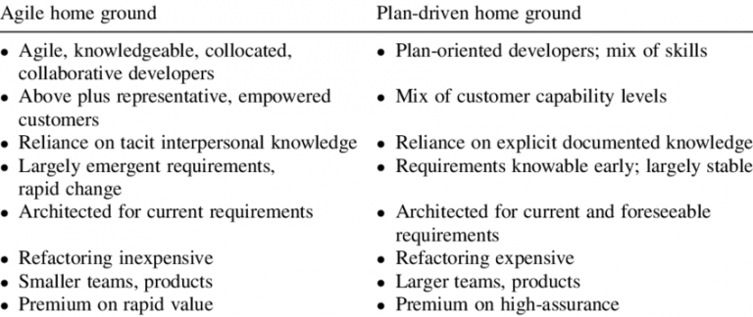
Plan vs Agile

Slide 15
Context models
Context models are used to illustrate the operational context of a system - they show what lies outside the system boundaries.
Social and organisational concerns may affect the decision on where to position system boundaries.
Architectural models show the system and its relationship with other systems.

Slide 16
System boundaries
System boundaries are established to define what is inside and what is outside the system.
They show other systems that are used or depend on the system being developed.
The position of the system boundary has a profound effect on the system requirements.
Defining a system boundary is a political judgment
There may be pressures to develop system boundaries that increase / decrease the influence or workload of different parts of an organization.

Slide 17
The context of the Mentcare system

Slide 18
Sequence diagrams
Sequence diagrams are part of the UML and are used to model the interactions between the actors and the objects within a system.
A sequence diagram shows the sequence of interactions that take place during a particular use case or use case instance.
The objects and actors involved are listed along the top of the diagram, with a dotted line drawn vertically from these.
Interactions between objects are indicated by annotated arrows.

Slide 19
Sequence diagram for View patient information

